Slide 1

TraderX + VUU: Accelerating collaboration using GitHub Codespaces
Dov Katz
Cliff Tiltman
Chris Stevenson
@dovops
@ctiltman
@chrisjstevo

Slide 2
Important Tech Definition
MTTD: Mean Time to Detect
MTTD: Mean Time to Demo

Slide 3
TraderX: What and Why?
Industry relevant example
Generic, clean-IP for cross company collaboration
‘Something you might find in production …’
Accessible to any developer
Easy to demonstrate, etc.
Minimal pre-assumptions
Starting point for integrating/customizing
‘Show us what you mean – in code…’

Slide 4
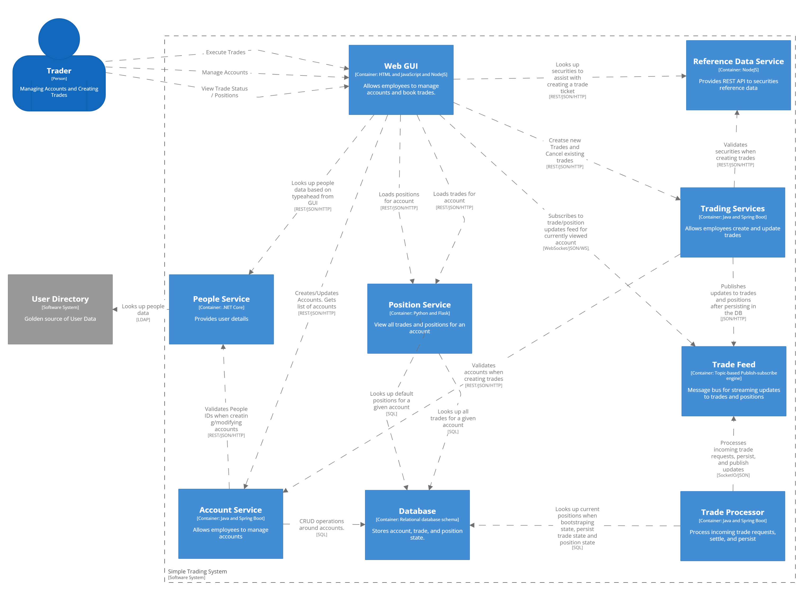
Quick Architectural Overview (1/2)

Slide 5
Quick Architectural Overview (2/2)
Small, simple(ish) codebases
Multiple independent microservices (but imagine as any distributed processes)
Currently as a monorepo
Something you can run in your IDE
‘Intentionally Chatty’
First working copy from a hackday.
Designed to extend

Slide 6
How did we build this?
VSCode (even for Java)
GitHub Codespaces
vscode.dev on top of public cloud compute
ngrok tunnels if needed
java/gradle, .net core, nodejs

Slide 7
Demo – traderX in Action

Slide 8
Intro to vuu
[Placeholder]

Slide 9
How vuu fits into the architecvture
[Placeholder]

Slide 10
Demo : traderX + vuu

Slide 11
Where else could this go…?
Limit checks using Morphir
Advanced data views using VUU
Apply CDM to the data exchanges
Integrate multiple screens/apps with FCD3
Create a Symphony chat bot using BDK/WDK
Try out new tech approaches
Demonstrate industry standards (Service mesh, Serverless, reach-out/back, etc). Experiment in the office, or at home.

Slide 12
What should we do next?
API Aggregator/gateway underneath web tier.
Improve documentation
Orderly start-up scripts, environment configuration
Extension lessons for containerization, etc
Hosted turn-key instance in a container (with code-server to locally develop)
Improve UX – Keep simple but make it more trading-like

Slide 13
Find out more
Git Repos
finos-labs/traderX
finos/vuu
More about Vuu
https://vuu.finos.org/
We encourage you to get involved!

